Slide 1
Foundations of Data Science – Mini Project
Flori Margaritescu, Litu Zou, Ze Cao, Ashton Begen

Slide 2
Dataset
All flights during January 2019 from a variety of US airports and their delay/cancellation information. The data is from the Bureau of Transportation Statistics, Govt. of the USA.
The original column headers were: Day of Month, Day of Week, Carrier Airline, Carrier Code, Unique Carrier Code, Tail Number, Flight Number, Origin Airport, Origin Airport ID, Destination Airport, Destination Airport ID, Departure time, Departure Delay (1 if more than 15 minutes, 0 if less than), Arrival Time, Arrival Delay (1 if more than 15 minutes, 0 if less than), Cancelled, Diverted, and Distance.
Link to the data: https://www.kaggle.com/divyansh22/flight-delay-prediction

Slide 3
Question
Predicting the probability of a flight delay from existing data from the dataset.
Flight delays are always an inconvenience, especially in cases with connecting flights or tight schedules. Being able to predict the probability of a flight being delayed beforehand could always be beneficial as to avoid scheduling conflicts.
It’s an interesting prediction problem as it applies and has applied to many people who have been stuck in unfortunate situations due to delays, situations that could potentially be avoided if the risk of delay was predictable! (Not that many people are flying places just now…)

Slide 4
Dataset cleaning & utilisation
The dataset, when downloaded, had columns of different types (numerical, alphabetical) and NaN values. Before beginning to tackle our prediction problem we removed unnamed columns such as the index and removed columns with NaN values that were irrelevant and would complicate our analysis later on. These were rows with flight time data that didn’t exist in the dataset but that were not delayed or cancelled, whereas cancelled flights with NaN flight times were kept in as relevant.
All times were converted to 24 hour time for ease of processing. A column was also added with departure and arrival times in minutes to make for easier calculations of flight time.
Irrelevant and duplicated data was also filtered out.

Slide 5
Tool
This is a prediction problem with an aim to predict flight delay based on: Distance between origin and destination, departure time, total travel minutes, the day of the month, the day of the week, flight number, and origin and destination airports.
These columns are directly relevant to the delay, with columns such as carrier, origin airport ID and destination airport ID being removed for either irrelevance or some repetitive nature.
PCA was used to reduce dimensions whilst preserving data accuracy, the program was trained with the reserved data, and then KNN with false positive and false negative values was used to observe the ‘best’ k-value and from there to see the accuracy of our prediction.

Slide 6
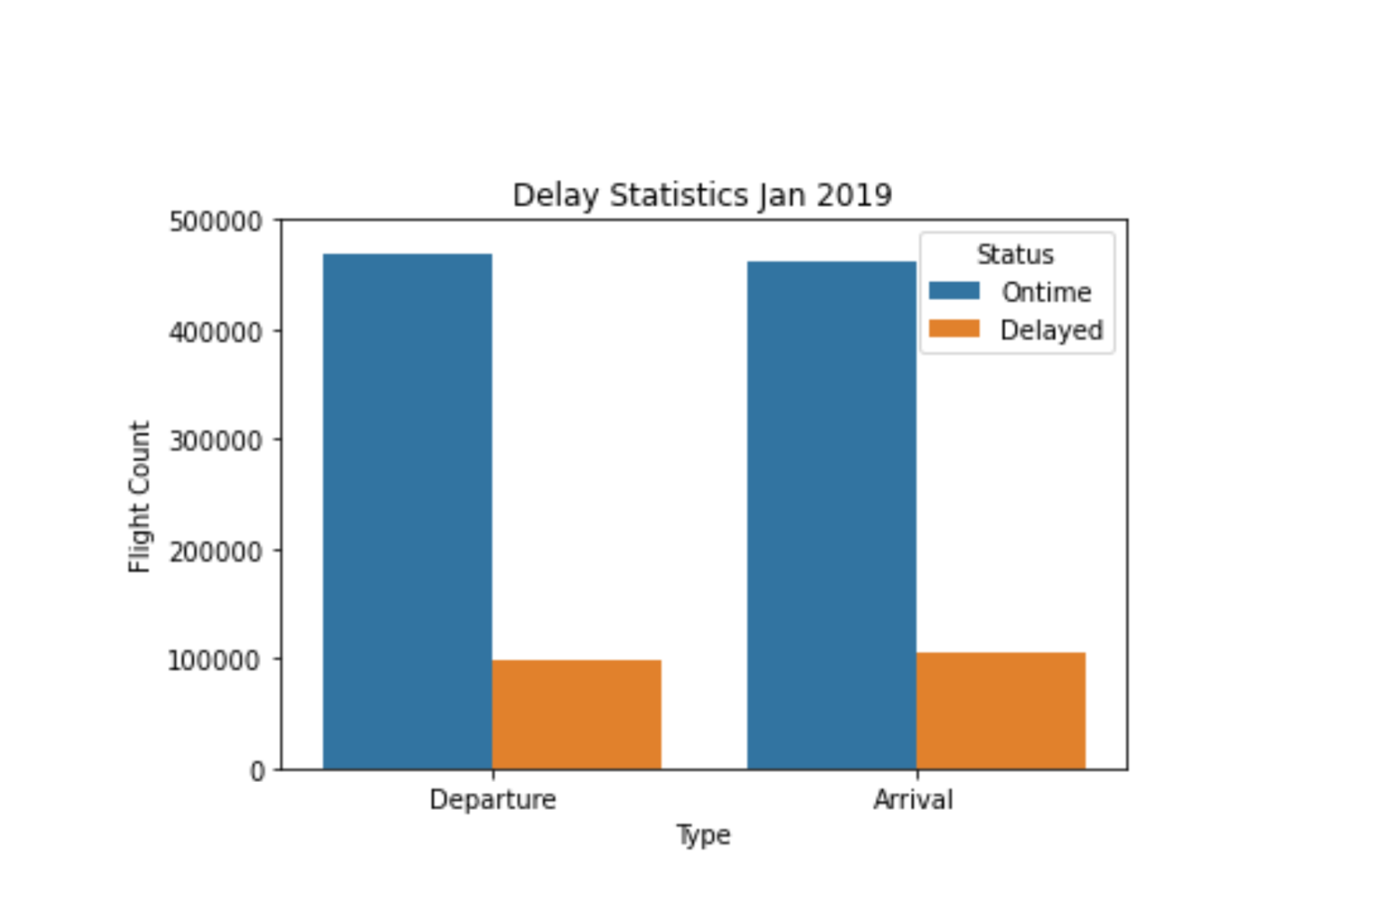

Slide 7
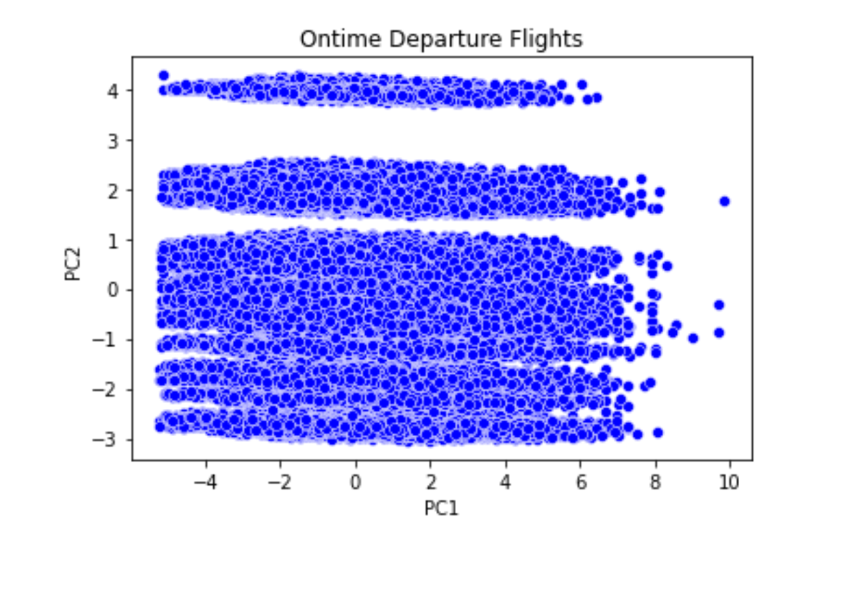

Slide 8
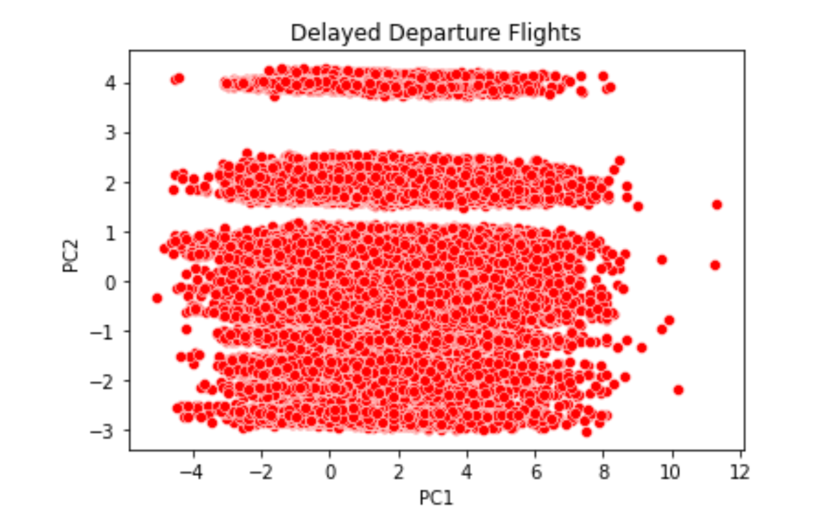

Slide 9
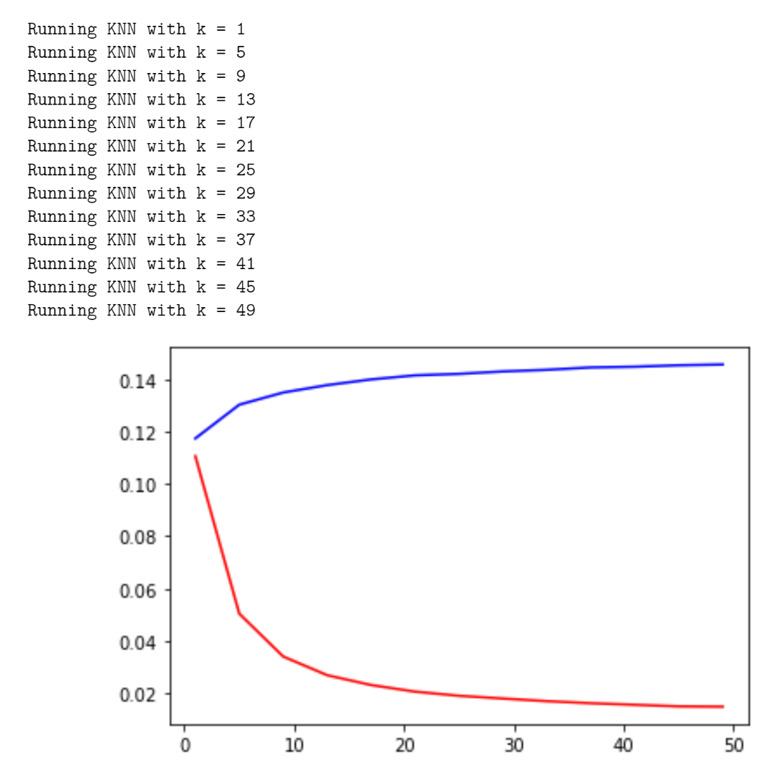

Slide 10
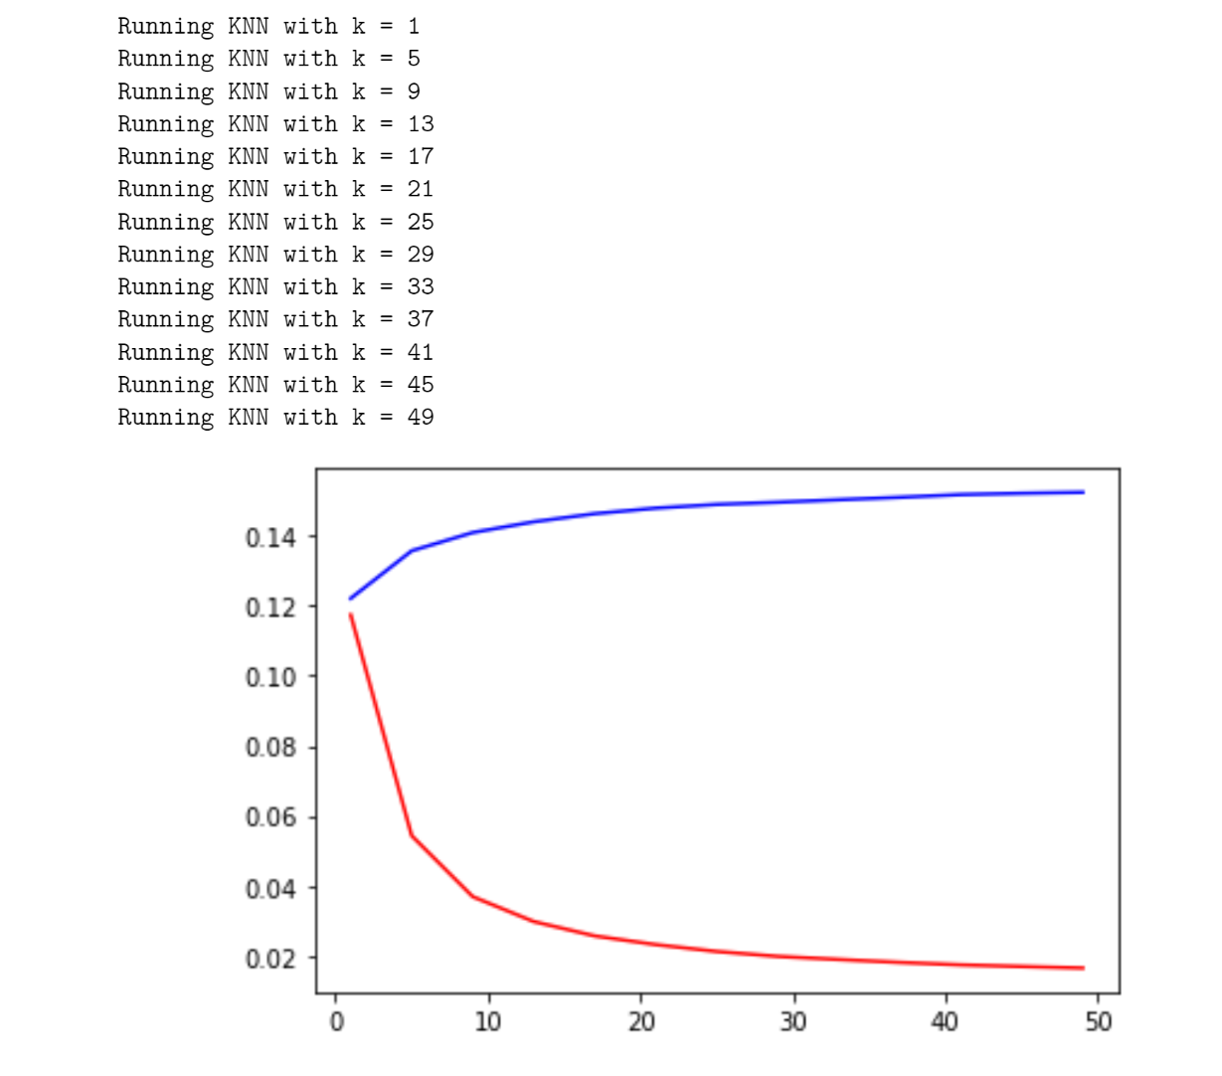

Slide 11
Analysis and Findings
From the original data, the number of flights NOT delayed is significantly larger than the number which are. This mirrors our own prediction through the regression model, but also means that the probability of a false positive is less than that of a false negative.
Can be seen on notebook more clearly and in context.

Slide 12
Limitations
The data used, while containing some relevant data to the probability of flight delay, also does not contain many relevant factors to an accurate prediction. One such factor could be weather conditions, or previous journey lengths, or even previous delay and diversion. All these factors could make for a more accurate prediction.
However the data used was unbiased as it was simply statistics from the Govt. of the USA on flight information, delay, and cancellations.

Slide 13
Future Directions
Whilst exploring our data, the question of other factors affecting flight delay and cancellation came up. Our dataset did not contain enough information to get an idea of, for example, the most influential factors on flight cancellation.
If we were to investigate the factor most likely to result in a flight cancellation, we would need additional data on all potential causes of flight cancellation. This would potentially be a massive dataset and would have to be thoroughly filtered on a probability basis to see an accurate picture.
It would be interesting to see, however, as we focused only on delay in this project and not on cancellation as the data we had was not sufficient.

